Slide 1
Distributed Systems
Edited/Reviewed By: Dr. Anas Youssef
Email: anas.youssef@ci.menofia.edu.eg

Slide 2
Distributed Systems
Course Overview
&
Introduction to Distributed Systems

Slide 3
List of topics
Course overview
Introduction to distributed systems
Introduction to Cloud Computing

Slide 4
Topic 1: Course Overview
Grading based on
Course work 30%
Midterm 15%
Section 15%
Final Exam 70%

Slide 5
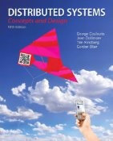
Course Book
Topic 1: Course Overview
 | Distributed Systems: Concepts and Design, (Fifth Edition), Coulouris G., J. Dollimore and T. Kindberg published by Addison Wesley, May 2011.

Slide 6
Additional reading
Topic 1: Course Overview
Distributed Systems: Principles and Paradigms (2nd edition), Andrew S. Tanenbaum, Maarten Van Steen, 2007.
Reliable Distributed Programming, Rachid Guerraoui and Luis Rodrigues 2011.
Software Modeling and Design: UML, Use Cases, Patterns, and Software Architectures, Hassan Gomaa , 2011.

Slide 7
Topic 1: Course Overview
This course addresses issues of software engineering topics in a distributed environment and distributed software applications, include web applications as well as other network environments.
The course examines issues that exist because of the complexity of software running simultaneously and asynchronously on multiple heterogeneous networks.
At the end of the course, students will have a deeper understanding of software engineering topics in a distributed environment. They will be better equipped to design, develop, test, and analyze the performance of distributed applications.

Slide 8
Topic 1: Course Overview
Lecture Title | Topic
Course Overview | introduction to distributed systems introduction to cloud computing
Characterization of Distributed Systems | Scalability Openness Heterogeneity Resource access and sharing Fault tolerance
Interprocess Communication | Transaction oriented Message oriented Remote invocation
Distributed Objects and Components | Middleware for Distributed Objects Distributed Software Architecture Service-Oriented Architecture Web Services

Slide 9
Topic 1: Course Overview
Lecture Title | Topic
Designing Distributed Systems | Analysis and design of distributed software Analysis methodologies Design Patterns
Synchronization, Concurrency and replication | Transactions and Concurrency Control Time and Global States Replication & Distributed data
Distributed system quality metrics and testing | Performance analysis Security Scalability

Slide 10
Topic 2: Introduction to distributed systems
Web definitions: http://en.wikipedia.org/wiki/Distributed_system
“Distributed computing is a field of computer science that studies distributed systems. A distributed system is a software system in which components located on networked computers communicate and coordinate their actions by passing messages.”
Google Code University:
“A distributed system is an application that executes a collection of protocols to coordinate the actions of multiple processes on a network, such that all components cooperate together to perform a single or small set of related tasks.”

Slide 11
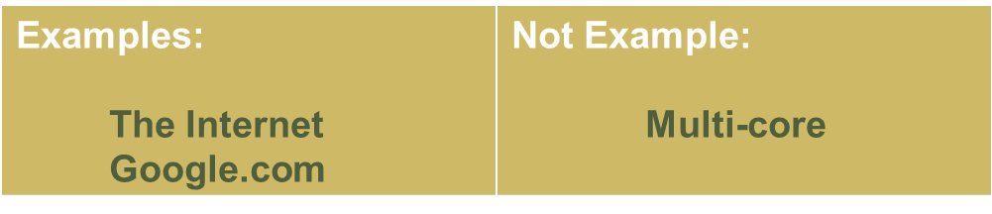
Topic 2: Introduction to distributed systems
Coulouris,
"A distributed system is a collection of hardware or software components that operate on computers connected to a data network and communicate and coordinate their activities only by messages.“

Slide 12
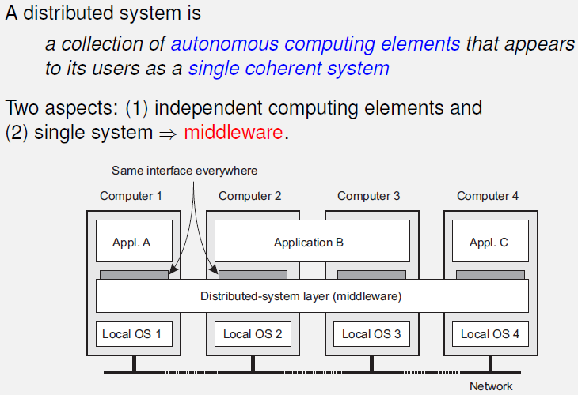
Topic 2: Introduction to distributed systems
Tanenbaum and Steen

Slide 13
Types of Distributed Systems
Topic 2: Introduction to distributed systems
Distributed computing systems
Distributed information systems
Distributed pervasive systems

Slide 14
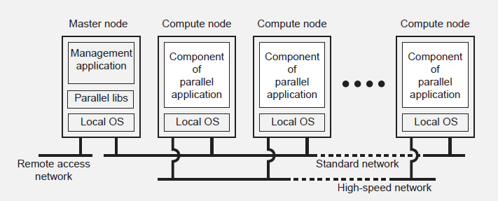
Topic 2: Introduction to distributed systems
Calculation-intensive Systems
High-performance computing
http://www.mimuw.edu.pl/~iwanicki/

Slide 15
Topic 2: Introduction to distributed systems
The majority of distributed systems in use today are forms
of traditional information systems (organizations' distributed systems).
Transactional systems (database systems, where the client requests the server to perform a series of operations)
Primitives
BEGIN_TRANSACTIONBEGIN (server, transaction)
END_TRANSACTION
ABORT_TRANSACTION
READ(transaction, file, data)
WRITE(transaction, file, data)

Slide 16
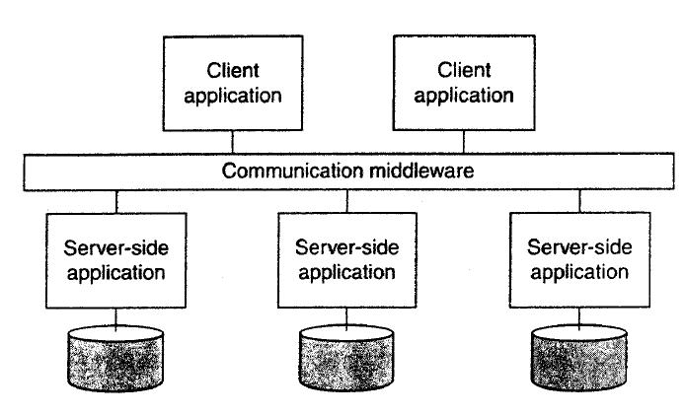
Topic 2: Introduction to distributed systems
Distributed Information Systems

Slide 17
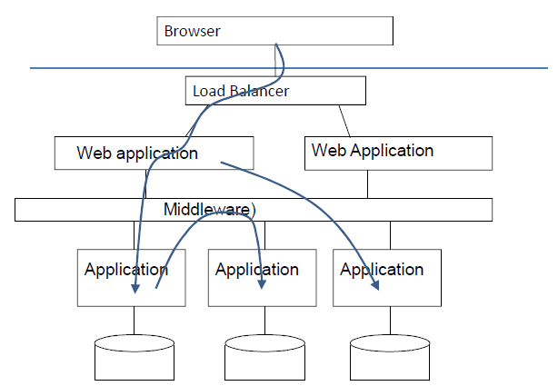
Topic 2: Introduction to distributed systems
A large Internet-based Information System
httphttp://www.cs.tut.fi/~hajap/
://www.cs.tut.fi/~hajap/

Slide 18
Topic 2: Introduction to distributed systems
Distributed Pervasive Systems
Embedded Distributed Systems
Mobile and Ubiquitous systems
Observation
Nowadays the nodes of a distributed system are Small portable devices with wireless networking (often embedded in a larger system).
These nodes include PDAs, Smart phones, laptops, devices embedded in automobiles and smart watches.

Slide 19
Topic 2: Introduction to distributed systems
Pervasive Systems: Examples
Modern car
Aircrafts systems
Electronic health systems
Smart houses (intelligent houses)
Sensor networks
Lots of examples exist

Slide 20
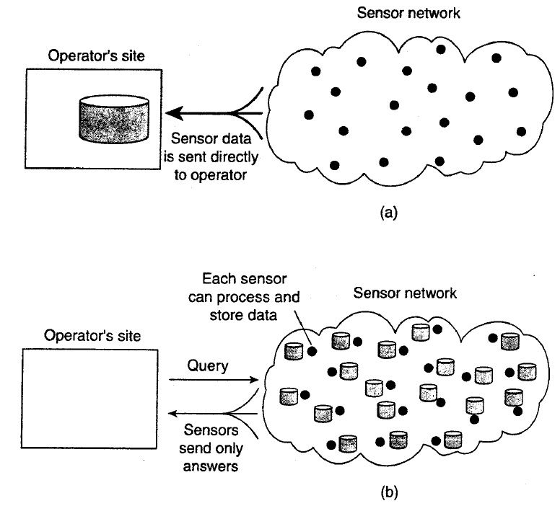
Topic 2: Introduction to distributed systems
Distributed Pervasive Systems

Slide 21
Topic 2: Introduction to distributed systems
Important Factors
End-User
Environment
Personalized
Response
Predictable
Independency
Location Independence
Platform Independence

Slide 22
Topic 2: Introduction to distributed systems
Important Factors
Application Developer
Code Reusability
Interoperability
Reduced Complexity
Portability

Slide 23
Topic 2: Introduction to distributed systems
Important Factors
System Administrator
Changing Technology
Lack of Management Tools
Increased Complexity

Slide 24
Topic 2: Introduction to distributed systems
Challenges in Distributed Systems
Business applications are less challenging than scientific applications:
Simple models are adequate
Client/Server applications are dominant

Slide 25
Topic 2: Introduction to distributed systems
Challenges
The concerns introduced at the end of chapter one in Coulouris et al will be our topics for discussion in next lecture.
Heterogeneity
Openness
Security
Scalability
Failure Handling
Concurrency
Transparency

Slide 26
Topic 3: Introduction to Cloud Computing
Definition
Cloud computing is the delivery of computing as a service rather than a product, whereby shared resources, software, and information are provided to computers and other devices as a metered service over a network (typically the Internet).
Wikipedia

Slide 27
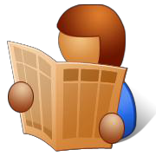
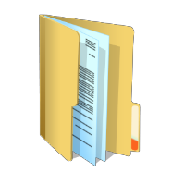
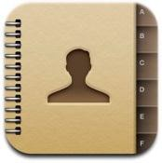
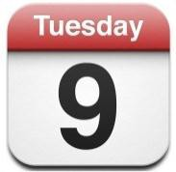
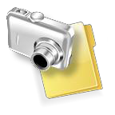

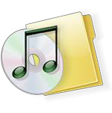

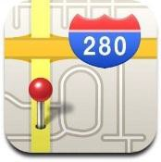

Topic 3: Introduction to Cloud Computing
Our Data Now…
Personal Data
Emails, Calendars, Contacts, Location Information, etc…
Documents and Media
http://www.qatar.cmu.edu/~msakr/15319-s12/

Slide 28
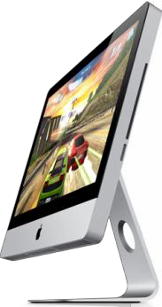
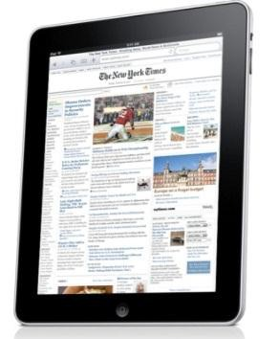
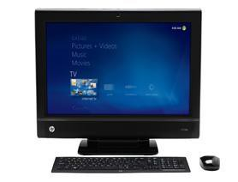
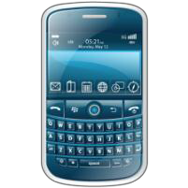
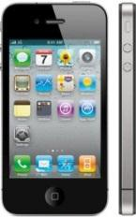
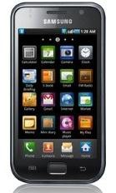
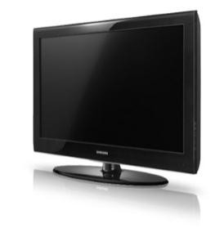
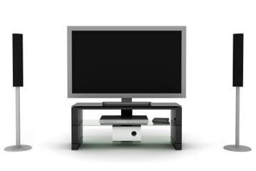
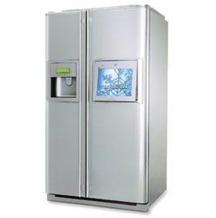
Topic 3: Introduction to Cloud Computing
Using Diverse Interfaces & Devices
Desktops
Mobile Devices
…and even appliances
Consumer
We also want to access, share and process our data from all of our devices, anytime, anywhere!
http://www.qatar.cmu.edu/~msakr/15319-s12/

Slide 29


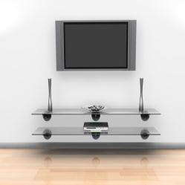


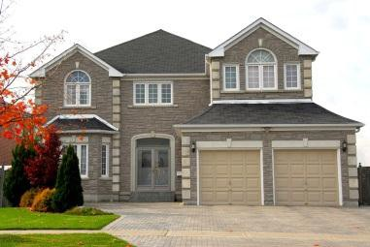
Topic 3: Introduction to Cloud Computing
 | …work | on documents?
…get your news & info?
How will you…
and share media?
…navigate?
…communicate with friends and family?
…live in an intelligent home?
…

Slide 30
Topic 3: Introduction to Cloud Computing
How Will We Manage Our Data?
Manage it ourselves?
Personal, but time consuming.
How would you get access to your data wherever you are?
Would you keep it on your devices?
or would you keep it online?
What if it’s managed
by someone else?
and you can get this “service” for
free or with a subscription?

Slide 31
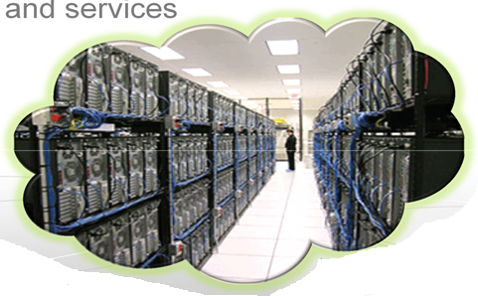
Topic 3: Introduction to Cloud Computing
A Cloud is …
A data center hardware and software that the vendors use to offer the computing resources
Distributed Systems

Slide 32



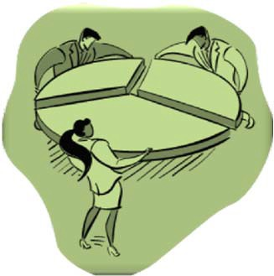
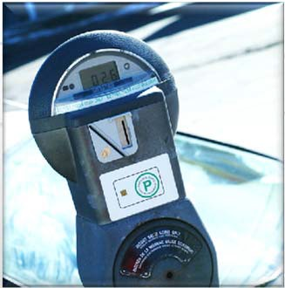
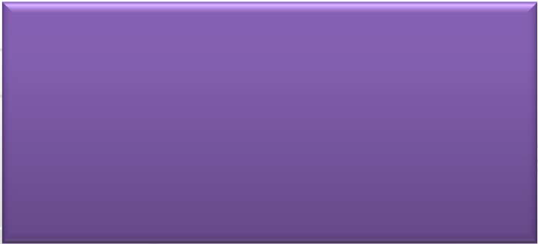
Topic 3: Introduction to Cloud Computing
Cloud Computing
Cloud Computing is the delivery of computing as a service rather than a product,
whereby shared resources, software, and information are provided to computers and other devices,
as a metered service over a network.
Distributed Systems

Slide 33
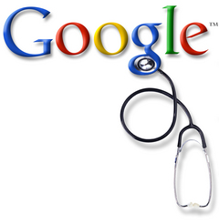
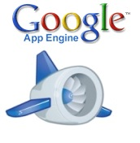

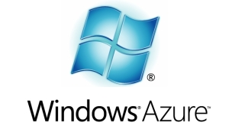


Topic 3: Introduction to Cloud Computing
The promise of the Cloud
Transformation of IT from a product to a service
Revolutionizing for health care, financial systems, scientific research, and society

Slide 34









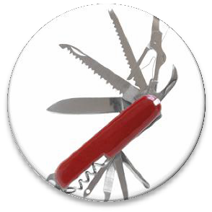


Topic 3: Introduction to Cloud Computing
Why Cloud Computing?
http://www.qatar.cmu.edu/~msakr/15319-s12/
Pay-as-You-Go | Simplified IT | Scale quickly | Flexible options | Resource | Carbon
economic model | management | and effortlessly | Configure software | Utilization is | Footprint
Reduce capital expenditure
No upfront cost
Reduced Time to Market
All you need is access to the internet.
It’s the providers responsibility to manage the details.
Resources can be rented and released as required
Software Controlled
Instant scalablility
packages, instance types operating systems.
Any software platform
Access from any machine connected to the Internet
improved
Reduce Idle resources by sharing and conolidation
Better utilization of CPU / Storage and Bandwidth.
decreased
Sharing of resources means less servers, less power and less emissions.

Slide 35
Topic 3: Introduction to Cloud Computing
Cloud Properties
Pooled resource
Network accessible
Virtualization
Elasticity
Automation
Metered billing

Slide 36
Topic 3: Introduction to Cloud Computing
Cloud Challenges
Quality of Service
Network Dependence
Vendor Lock-In, Storage Lock-in & Computation Lock-in
Non-standardized
Security Risks
Privacy

Slide 37
Topic 3: Introduction to Cloud Computing
IT as a Service
How do you offer IT as a service?
Different users have different needs
Consider the needs of:
Average End User
Mobile Application Developer
Enterprise System Architect
Let us look at some of the typical service models
Distributed Systems

Slide 38



Cloud Service Models
Topic 3: Introduction to Cloud Computing
SaaS
Software-as-a-Service
User applications running on browsers
PaaS
Platform-as-a-Service
A software platform that is made available to developers to build cloud applications
Infrastructure-as-a-Service
Basic computing resources such as CPU/Memory/Disk, made available to users in the form of Virtual Machine Instances
IaaS
IaaS
Distributed Systems

Slide 39
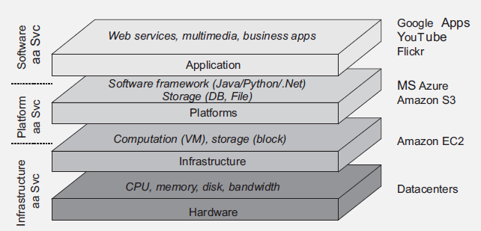
Topic 3: Introduction to Cloud Computing
Clouds
http://www.mimuw.edu.pl/~iwanicki/

Slide 40
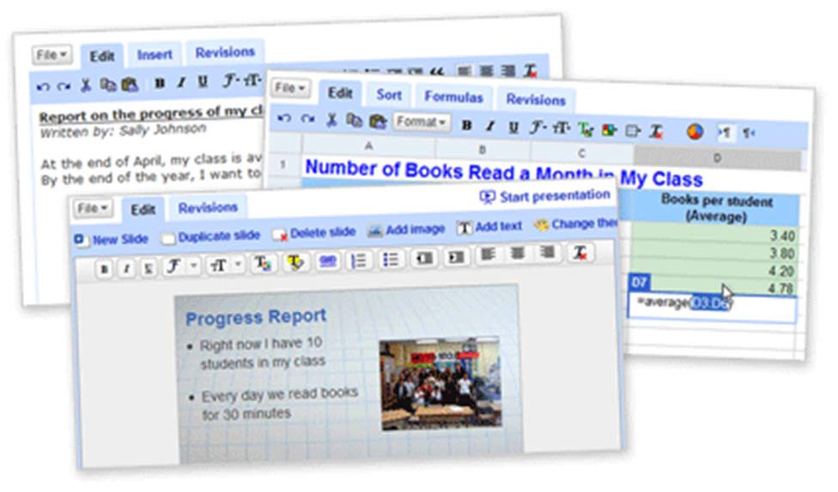
SaaS
Topic 3: Introduction to Cloud Computing
You are most familiar with this!
Software is delivered as a service over the Internet, eliminating the need to install and run the application on the customer's own computer
This simplifies maintenance and support
Examples: Gmail, YouTube, and Google Docs, among others
Distributed Systems

Slide 41
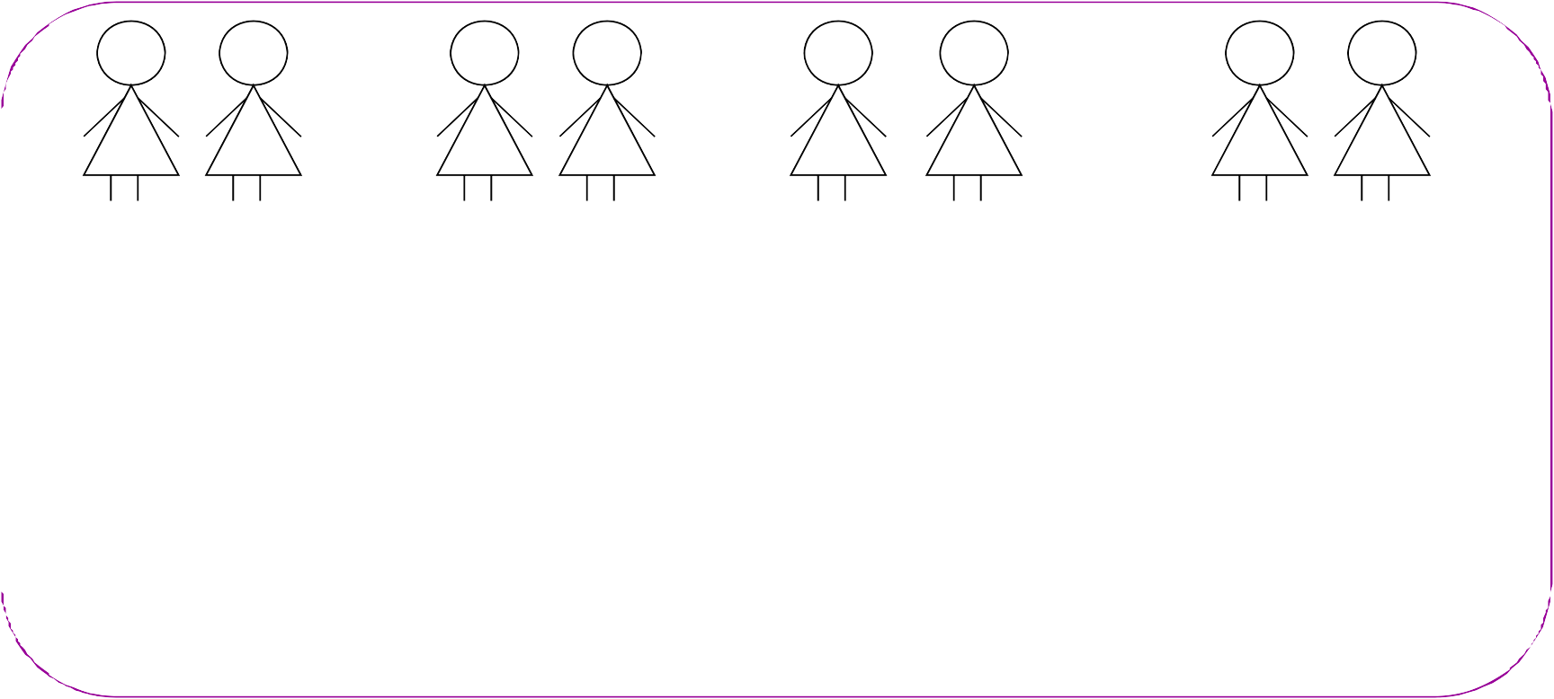
SaaS Maturity Levels
Topic 3: Introduction to Cloud Computing
Distinguishing attributes: configurability, multi-tenant efficiency, scalability
1
2
3
4
Tenant 1
Tenant 2
Tenant 1
Tenant 2
Tenant 1 Tenant 2
Tenant 1 Tenant 2
Tenant Load Balancer
instance 1
instance 2
instance instance
Configurable
Same application but distinct instance/customer
instance
instance
instance
+ Multi-tenant-efficient
(+):Efficient use of server resources without apparent differences to end users
(-): scalability limits
+ Scalable
Each has its own customized version of the application and run its own instance
Distributed Systems

Slide 42
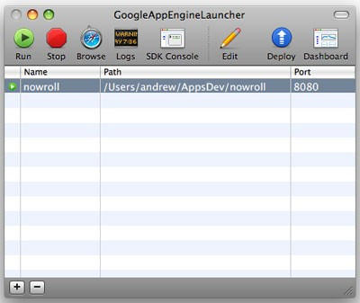
PaaS
Topic 3: Introduction to Cloud Computing
The Cloud provider exposes a set of tools (a platform) which allows users to create SaaS applications
The SaaS application runs on the provider’s infrastructure
The cloud provider manages the underlying hardware and requirements
Distributed Systems

Slide 43
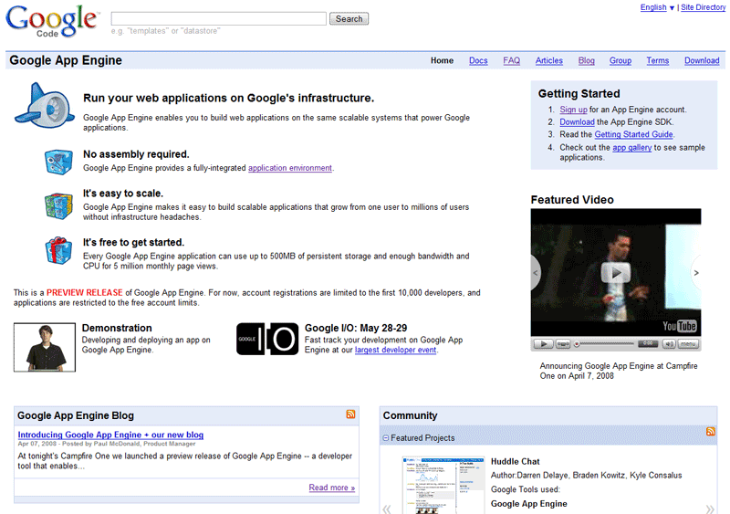
PaaS Example I
Topic 3: Introduction to Cloud Computing
Google App Engine
Build web applications on Google’s Infrastructure
Distributed Systems

Slide 44
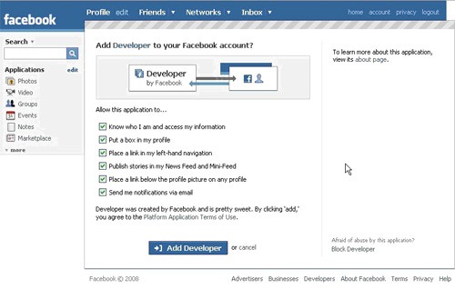
PaaS Example II
Topic 3: Introduction to Cloud Computing
The Facebook Developer Platform
Set of APIs that allow you to create Facebook Applications
Distributed Systems

Slide 45


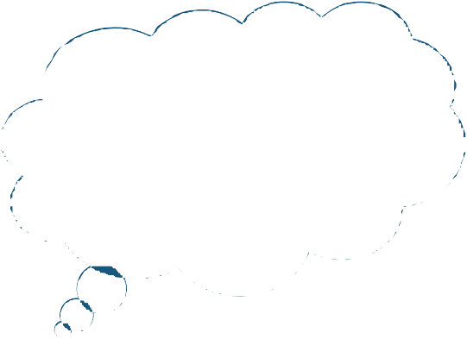
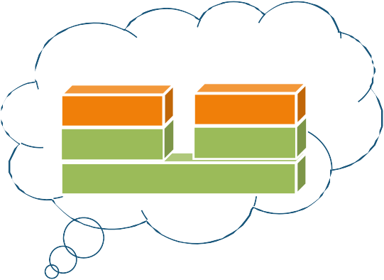




IaaS (1/2)
Topic 3: Introduction to Cloud Computing
The cloud provider leases to users Virtual Machine Instances (i.e., computer infrastructure) using the virtualization technology
The user has access to a standard Operating System environment and can install and configure all the layers above it
Cloud Provider
Distributed Systems

Slide 46

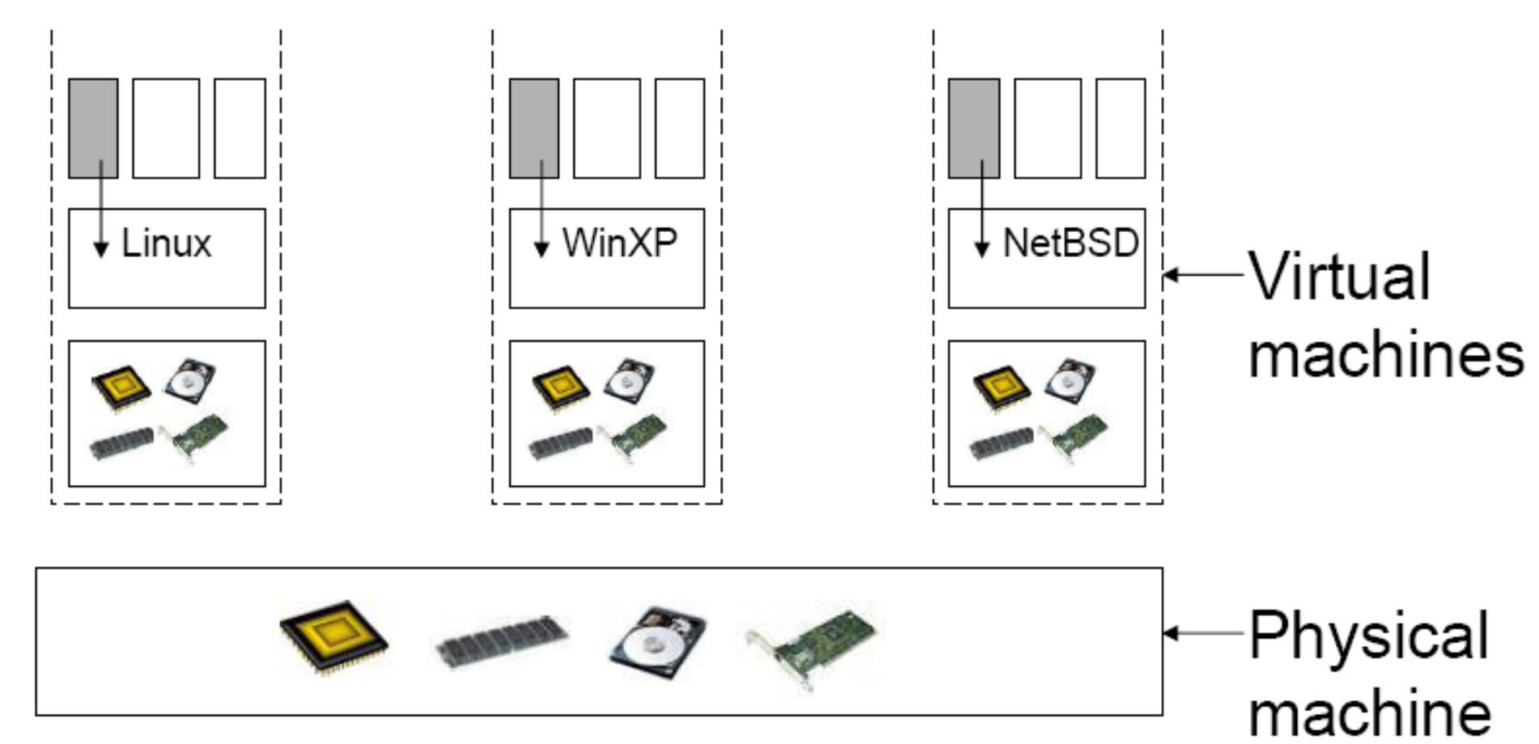



IaaS (2/2)
Topic 3: Introduction to Cloud Computing
The virtualization technology is a major enabler of IaaS
HARDWARE

Slide 47
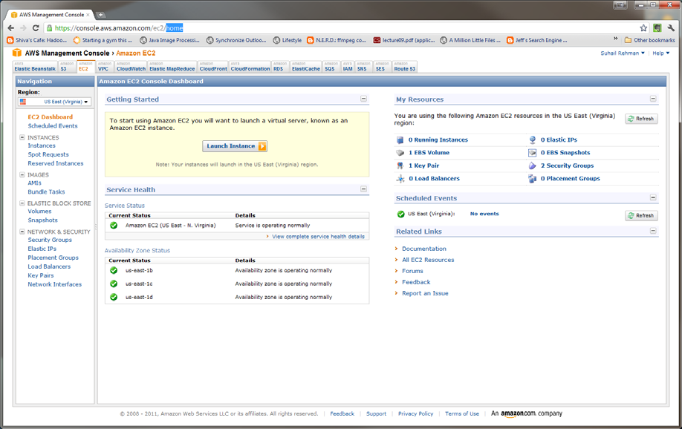
Topic 3: Introduction to Cloud Computing
IaaS Example
Amazon Web Service Elastic Compute Cloud (EC2)

Slide 48
Topic 3: Introduction to Cloud Computing
Other Service Models
Database-as-a-Service
Sensing-as-a-Service
XaaS
“X” as a Service

Slide 49
Topic 3: Introduction to Cloud Computing
The Cloud Software Stack
Applications Data Runtime Middleware
Operating System Virtualization
Servers
Storage Networking

Slide 50
Applications
Topic 3: Introduction to Cloud Computing
Cloud applications can range from Web applications to scientific computational jobs
Applications Data Runtime Middleware
Operating System Virtualization
Servers
Storage Networking

Slide 51
Data
Topic 3: Introduction to Cloud Computing
Data Management
New generation cloud- specific databases and management systems
E.g., Hbase, Cassandra, Hive, Pig etc.
Applications Data Runtime Middleware
Operating System Virtualization
Servers
Storage Networking

Slide 52
Runtime Environment
Topic 3: Introduction to Cloud Computing
Runtime platforms to support cloud programming models
E.g., MPI, MapReduce, Pregel etc.
Applications Data Runtime Middleware
Operating System Virtualization
Servers
Storage Networking

Slide 53
Middleware for Clouds
Topic 3: Introduction to Cloud Computing
Management platforms that enable:
Resource Management
Monitoring
Provisioning
Identity Management and Security
Applications Data Runtime Middleware
Operating System Virtualization
Servers
Storage Networking

Slide 54
Operating Systems
Topic 3: Introduction to Cloud Computing
Standard Operating Systems used in Personal Computing
Packaged with libraries and software for quick deployment and provisioning
E.g., Amazon Machine Images (AMI) contain OS as well as required software packages as a “snapshot” for instant deployment
Applications Data Runtime Middleware
Operating System Virtualization
Servers
Storage Networking

Slide 55
Virtualization
Topic 3: Introduction to Cloud Computing
Key Component
Resource Virtualization
Amazon EC2 is based on the Xen virtualization platform
Applications Data Runtime Middleware
Operating System Virtualization
Servers
Storage Networking

Slide 56
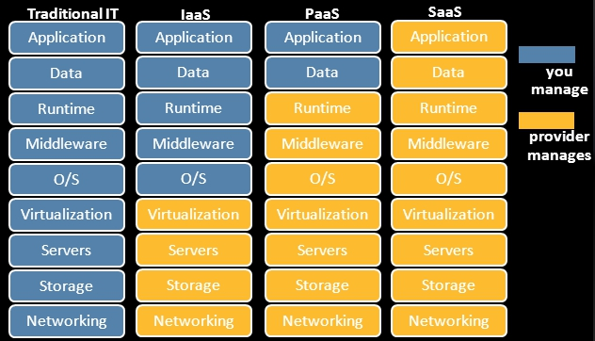
Three Cloud Service Models

Slide 57
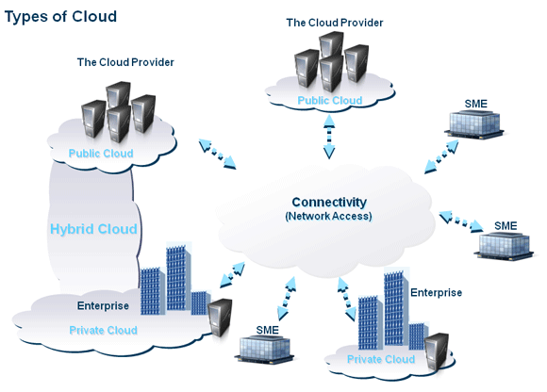
Topic 3: Introduction to Cloud Computing
Cloud Deployment Models
Public
Private
Hybrid

Slide 58
Topic 3: Introduction to Cloud Computing
Public (external) cloud
Open market for on demand computing and IT resources
Concerns: Limited SLA, reliability, availability, security, trust and confidence
Examples: IBM, Google, Amazon, …

Slide 59
Topic 3: Introduction to Cloud Computing
Private (Internal) cloud
For enterprises/corporations with large scale IT

Slide 60
Topic 3: Introduction to Cloud Computing
Hybrid cloud
Extend the private cloud(s) by connecting it to other external cloud vendors to make use of their available cloud services
Cloud Burst
Use the local cloud, and when you need more resources, burst into the public cloud

